Slide 1
Welcome

Slide 2
Project Name- Movie Ticket Booking Application
Name -
Pranav Suhas Pawar
Pravin Shyamlal Sharma
Punugula Udaya Jaya Lakshmi
Pushpak Sunil Chaudhari
Rakshitha G P
Rohan Pradipkumar Murtizapurkar
Sagar Shaurya Barnwal
Sahana R
Sahil Patel
Sailaja Kusampudi
Sangavarapu Ramya

Slide 3
INTRODUCTION

Slide 4
Tools and Technologies:
• Front-End: Angular
•Server-side: Spring Boot.
•Back-end: MYSQL, Hibernate.
•Server: Tomcat

Slide 5
System Design
System design is one of the activity that is required to build and verify software. The designer’s goal is to produce a model or representation of an entity that will later be built. Design provides us with representations of software that can assess for quality. Design is the only way that we can accurately translate a customer’s view into a finished software product or system.
There are two modules in this project:
User- who can book tickets
Administrator- who manages the movie information content

Slide 6
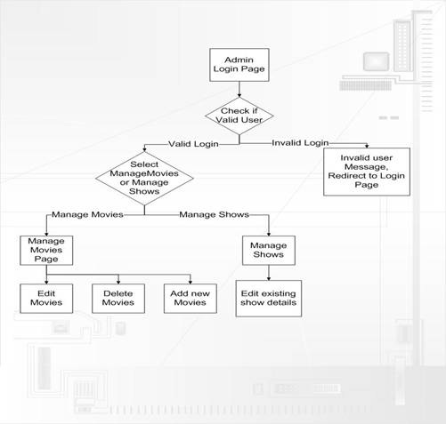
Data Flow Diagrams – Admin

Slide 7
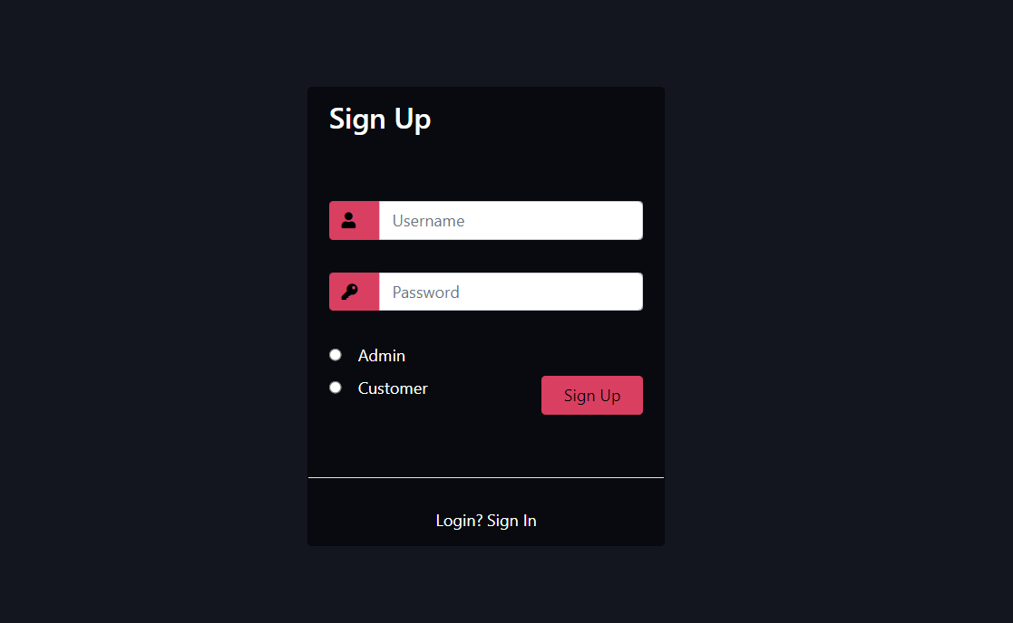
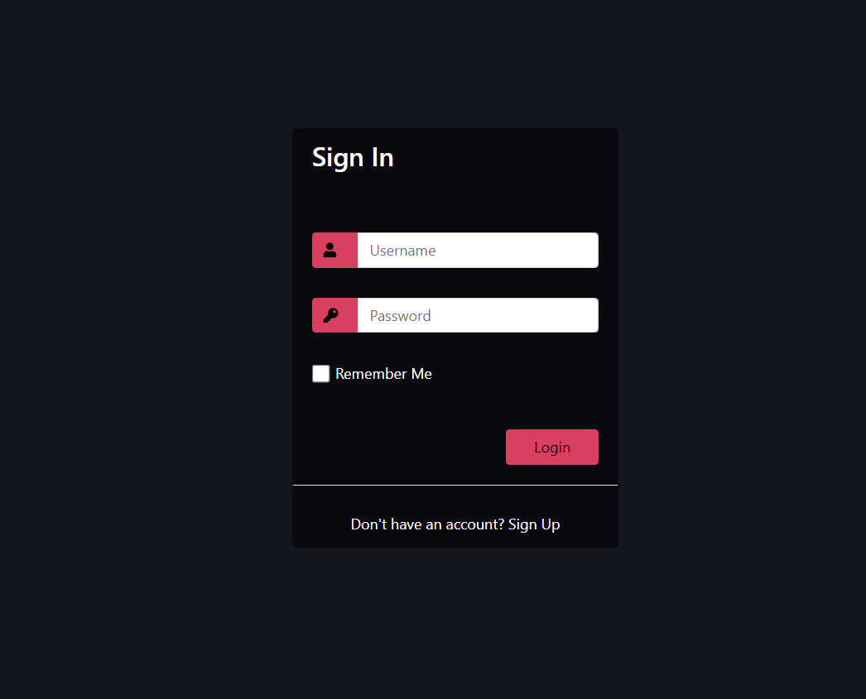
Sign Up & Sign In Option

Slide 8
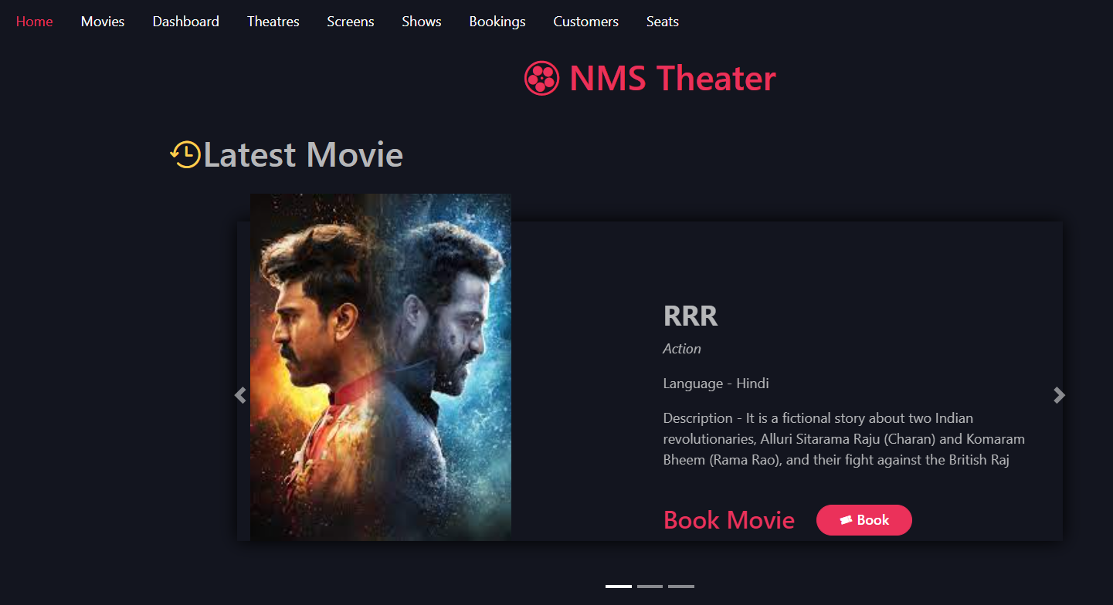
Home Page

Slide 9
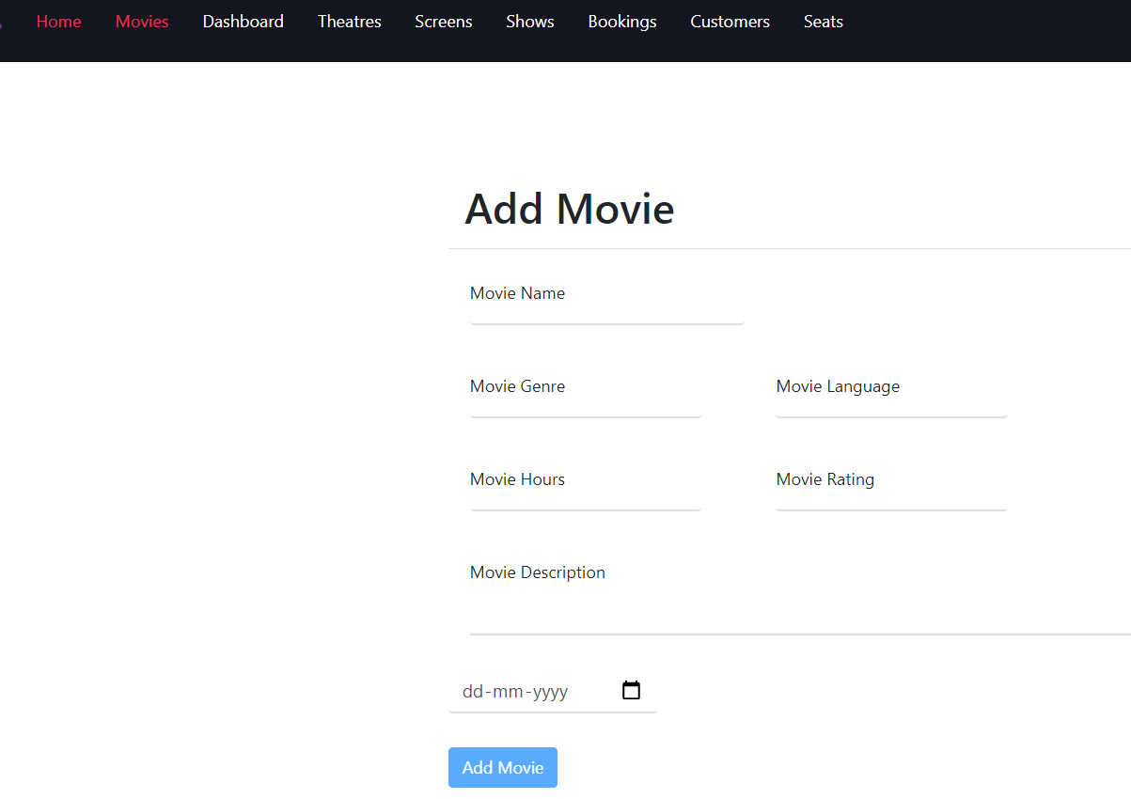
Add Movie

Slide 10
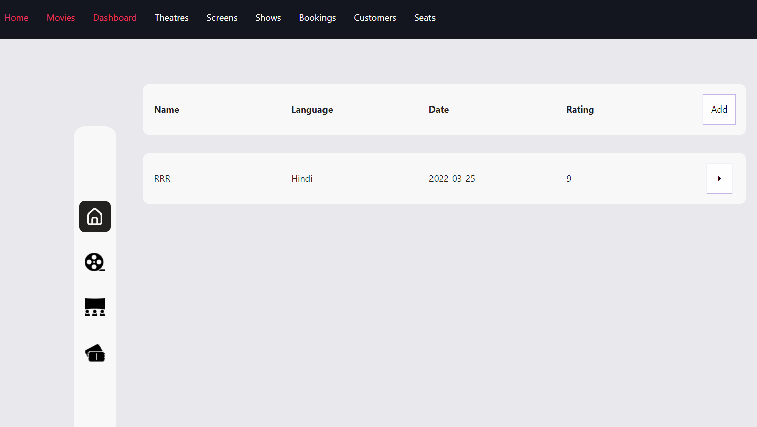
Dashboard

Slide 11
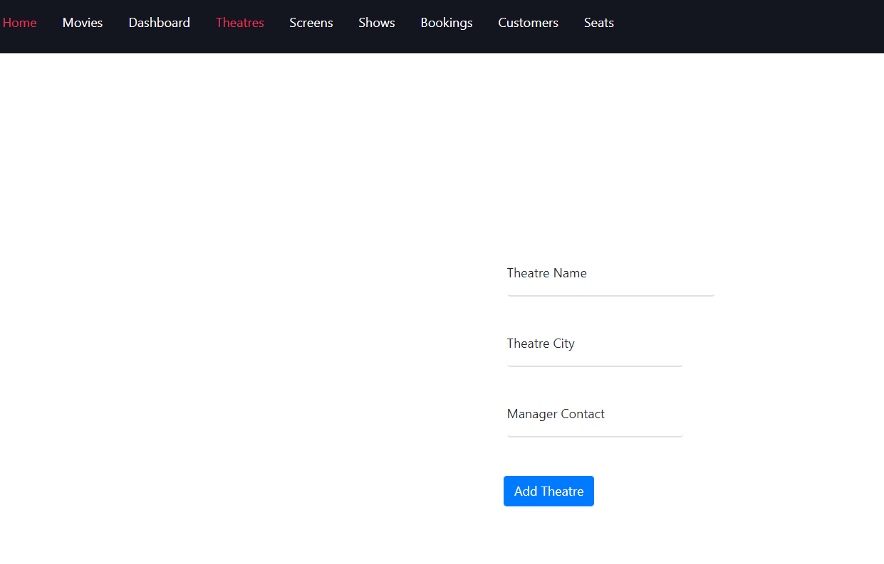
Add Theatre

Slide 12
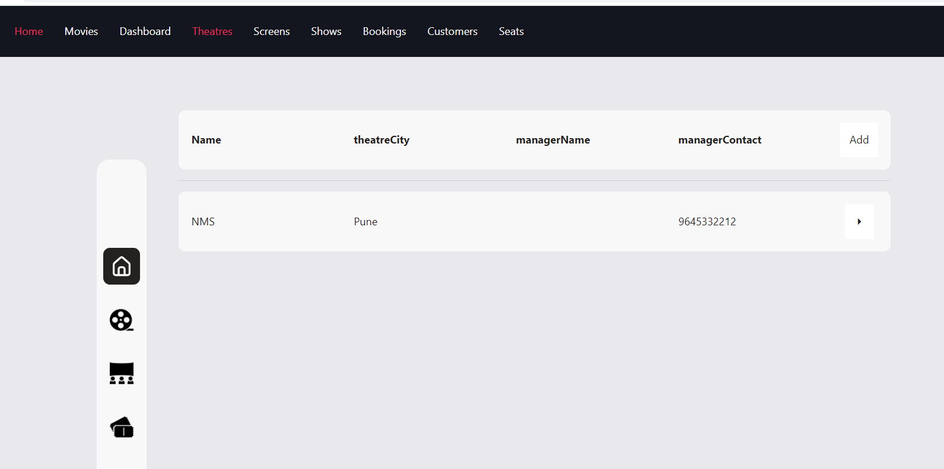
Theatre

Slide 13
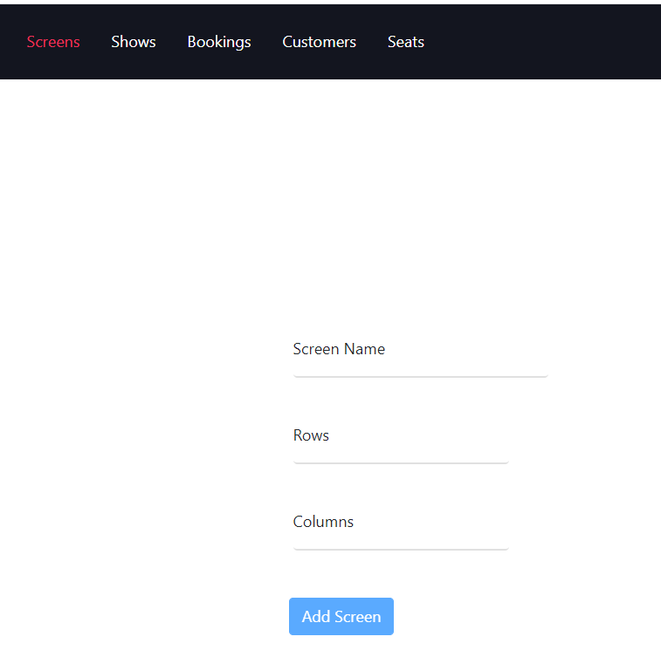
Add Screen

Slide 14
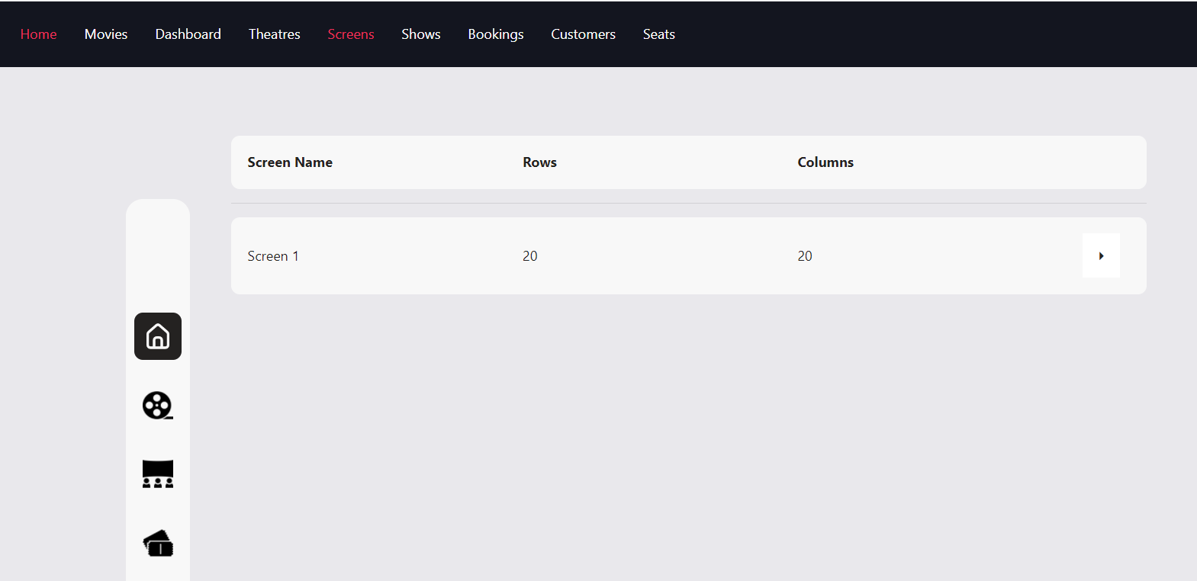
Screen

Slide 15
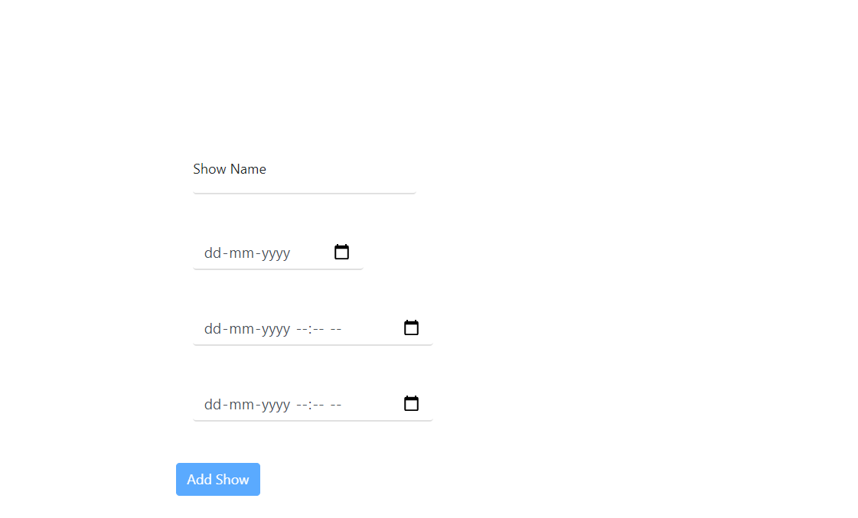
Add Shows

Slide 16
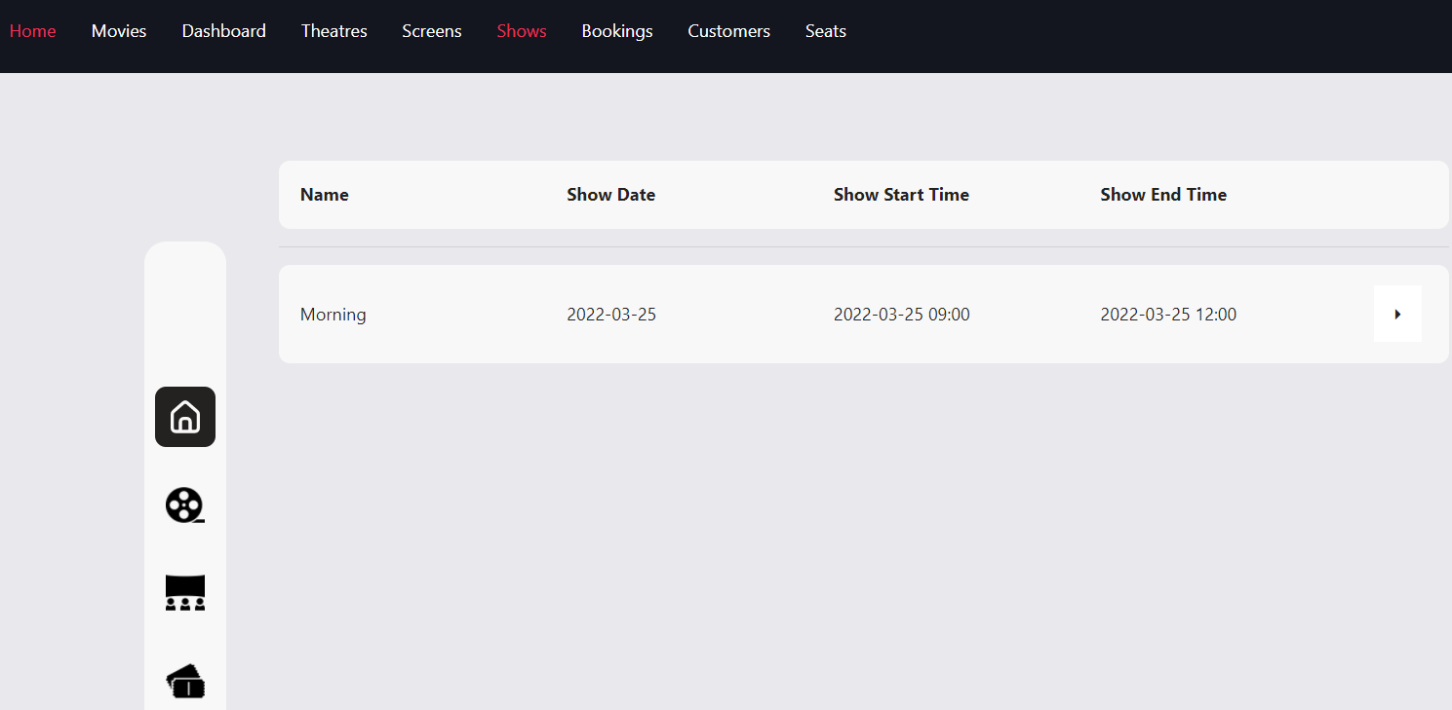
Shows

Slide 17
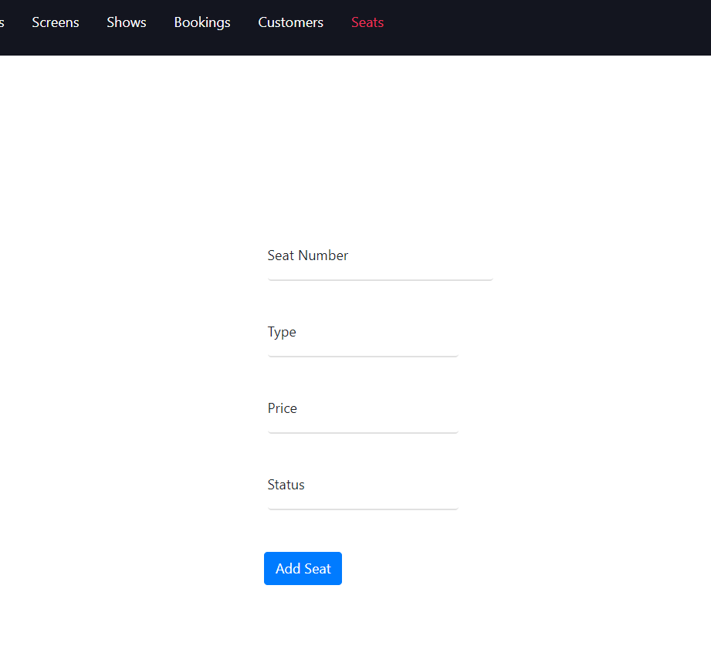
Add Seats

Slide 18
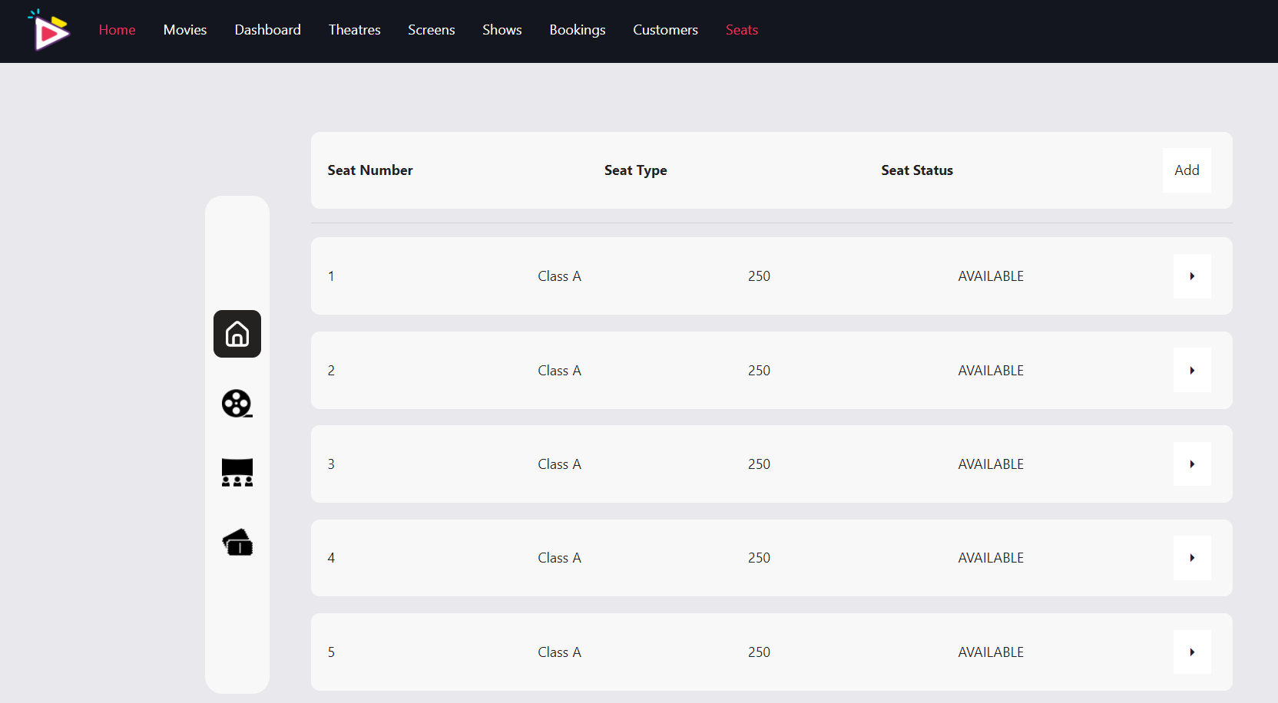
Seats

Slide 19
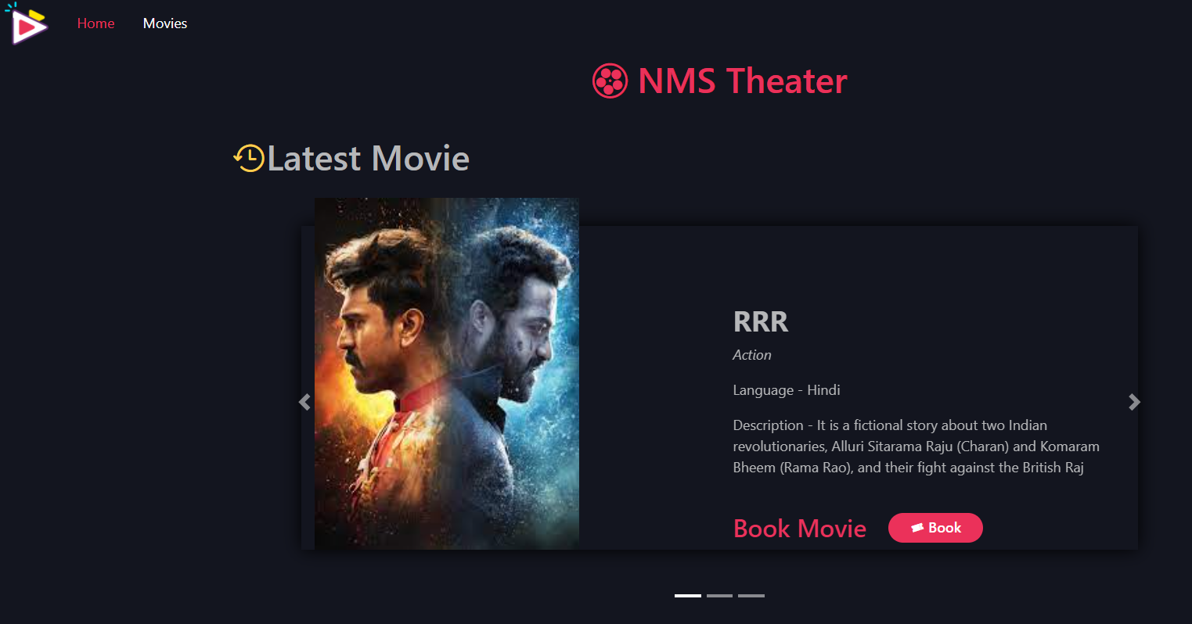
User End

Slide 20
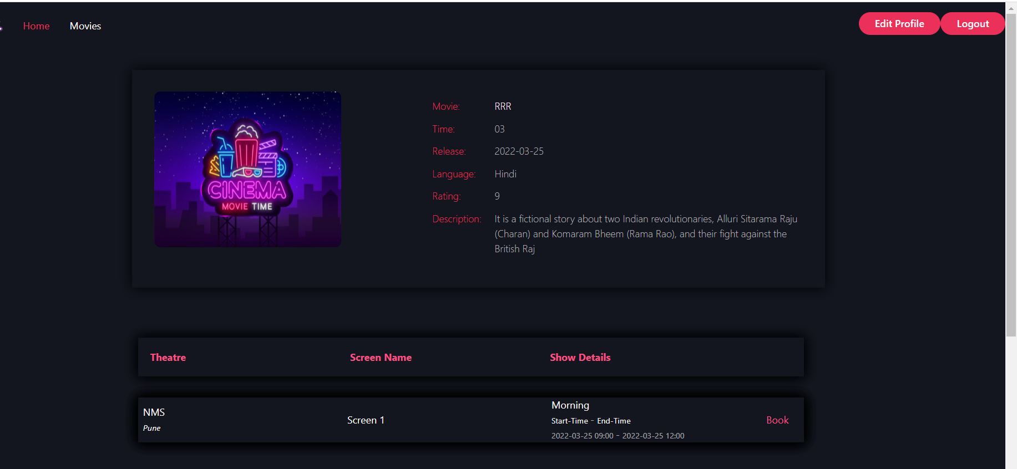
Book Movie Dashboard

Slide 21
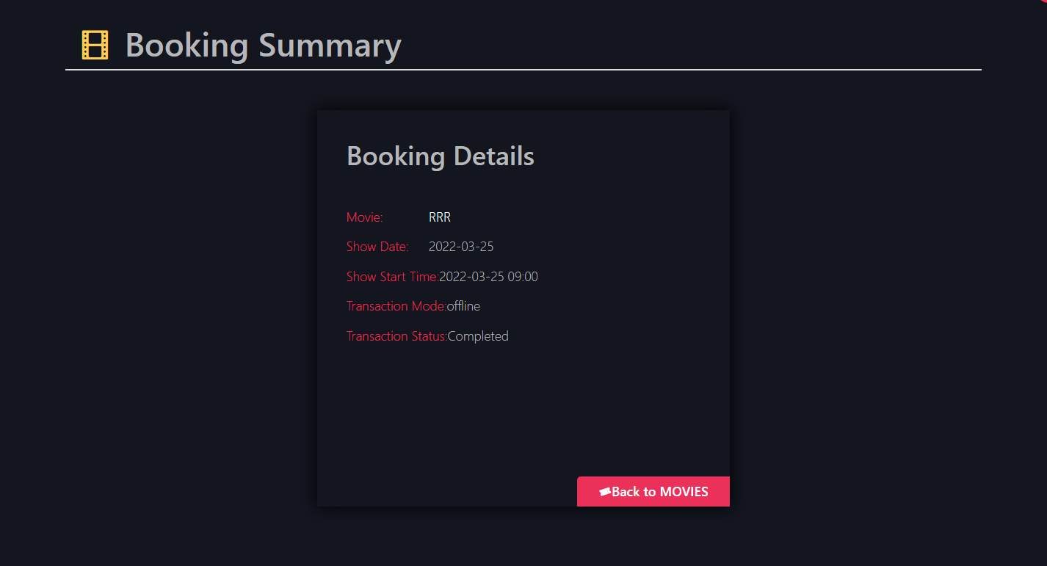
Booking Deatails

Slide 22
CONCLUSION
User friendly menu driven interface has been provided to the user to interact with the system. Users can traverse through the website provided the users have the access right set. The users can register themselves through a registration form and then can use the services of the website.
The system provides an integrated environment for the customers who are willing to watch movies currently running in the auditoriums in the theatres and can also enjoy combo packs while watching movie.

Slide 23
Limitation Of The Project
The username and password provided to us is not encrypted properly. Any person that gets to know the username and password of a user can access his account. So keep your password safe.
No Backup And Restore Utilities Are Incorporated
In these times of uncertainties, incorporation of the facilities of backup and restoration of last details is necessary. Any computer can crash or become affected by a virus at any time. So it is imperative to take the backup of the data, but this software does not provide this utility.

